Slide 1
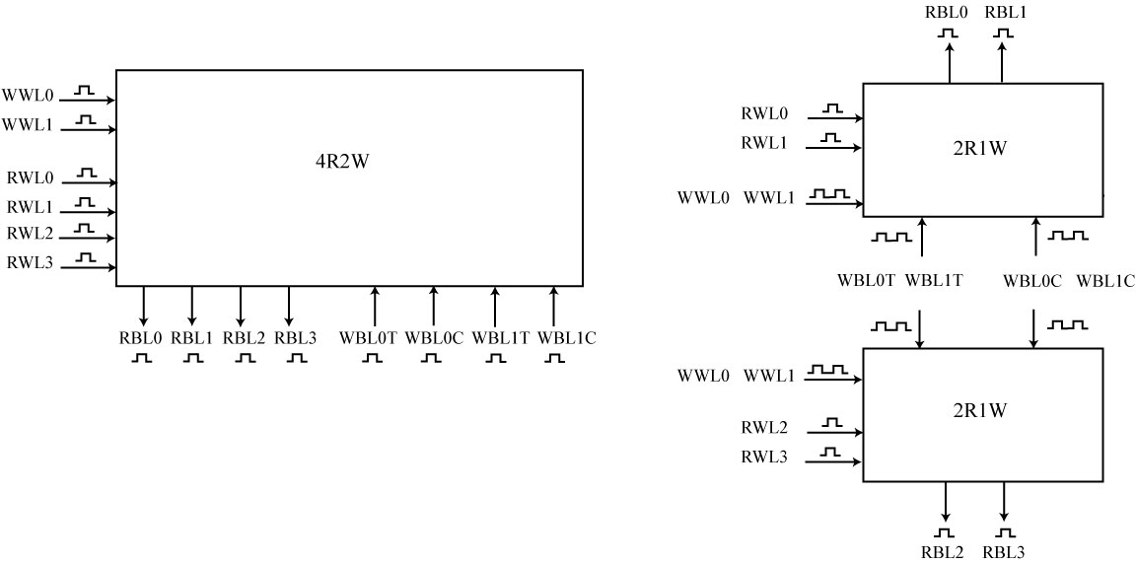
Actual 4R2W cell layout
Actual 2R1W cell layout
Actual 2R1W cell layout
Topology | 4R2W Cell | 2x2R1W Cell
Cell Area | 1x | 0.25x
Array Area | 1x | 0.6x
Read Operation | Single-pumped | Single-pumped
Write Operation | Single-pumped | Double-pumped
Error Detection and Correction | ECC | Parity
Figure 1: Implementation comparison for a 4R2W register file between usage of a traditional 4R2W cell and two copies of a 2R1W cell.

Slide 2
Problem statement – best total latency while minimizing area/power
Motivation: Why a DDR write dual copy register file
  Slide 1 double pump pro/con
  Slide 2 replication
Secondary Benefits of a DDRF register file duplicated parity
Difficulties of double pumping
  3 slides
Final results
  Overall size
  Overall delay
How it fits into the overall system
  Emphasis on usage
Future trends

Slide 3
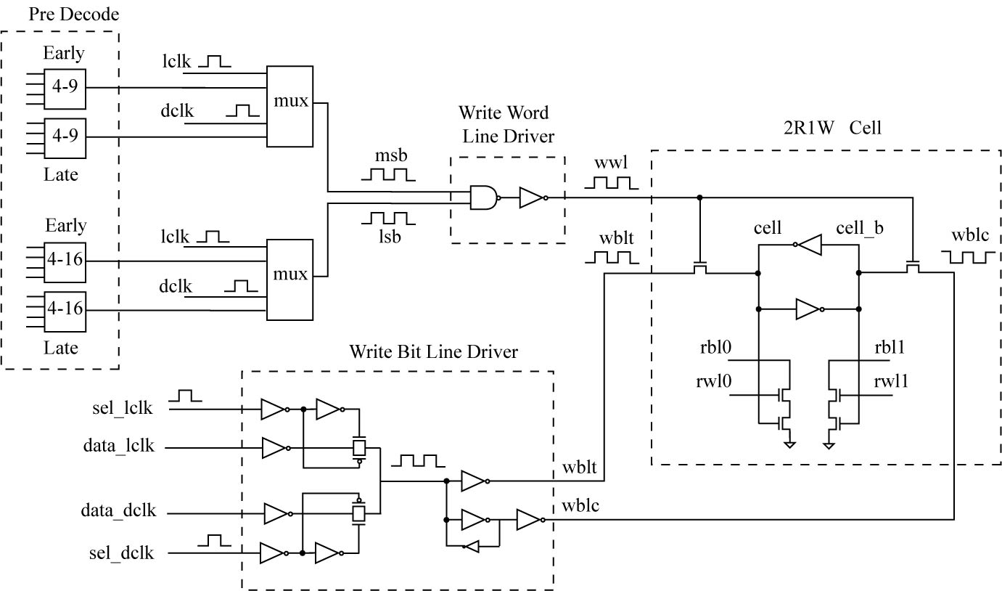
Write Cross Section
Figure 2: Circuit cross-section of the double-pumped write path in the implemented 4R2W register file array.

Slide 4
(Use real simulated waveforms here)
(convey blue information in a more aesthetically pleasing manner)
Cycle 1
Cycle 2
Ensure WWL<0> sufficiently close to ground
WWL<0>
Early
Write
Ensure WWL<1> sufficiently close to ground
WWL<1>
Late
Write
Ensure WBL setup/hold for Late Write
Next-Cycle
Early Write
WWL<2>
WBL
Ensure WBL setup/hold for Next-Cycle Early Write
Ensure late write completes before next-cycle read
Next-Cycle
Read
RWL<1>
RBLprecharge
Ensure no clock/data contention on RBL
RBL
Time
Figure 3: Waveforms depicting critical timing margins to ensure proper double-pumped write and fast read operation.

Slide 5
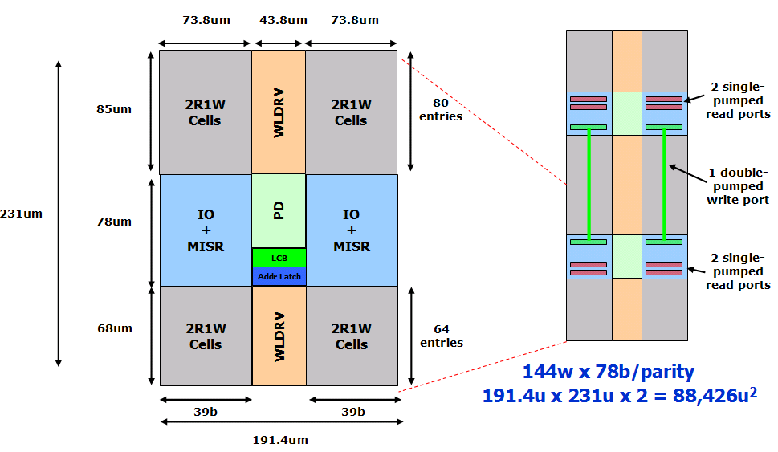
(Eliminate color)
(Glue on 2nd part to describe how parity = ECC? Ask Bruce)
2x2R1W arrays configured as effective 4R2W array
2R1W array
Figure 4: Floorplan of 4R2W register file depicting replicated 2R1W subarrays. Read ports are combined from the replicated arrays while the double-pumped write ports are accessed simultaneously in parallel.

Slide 6
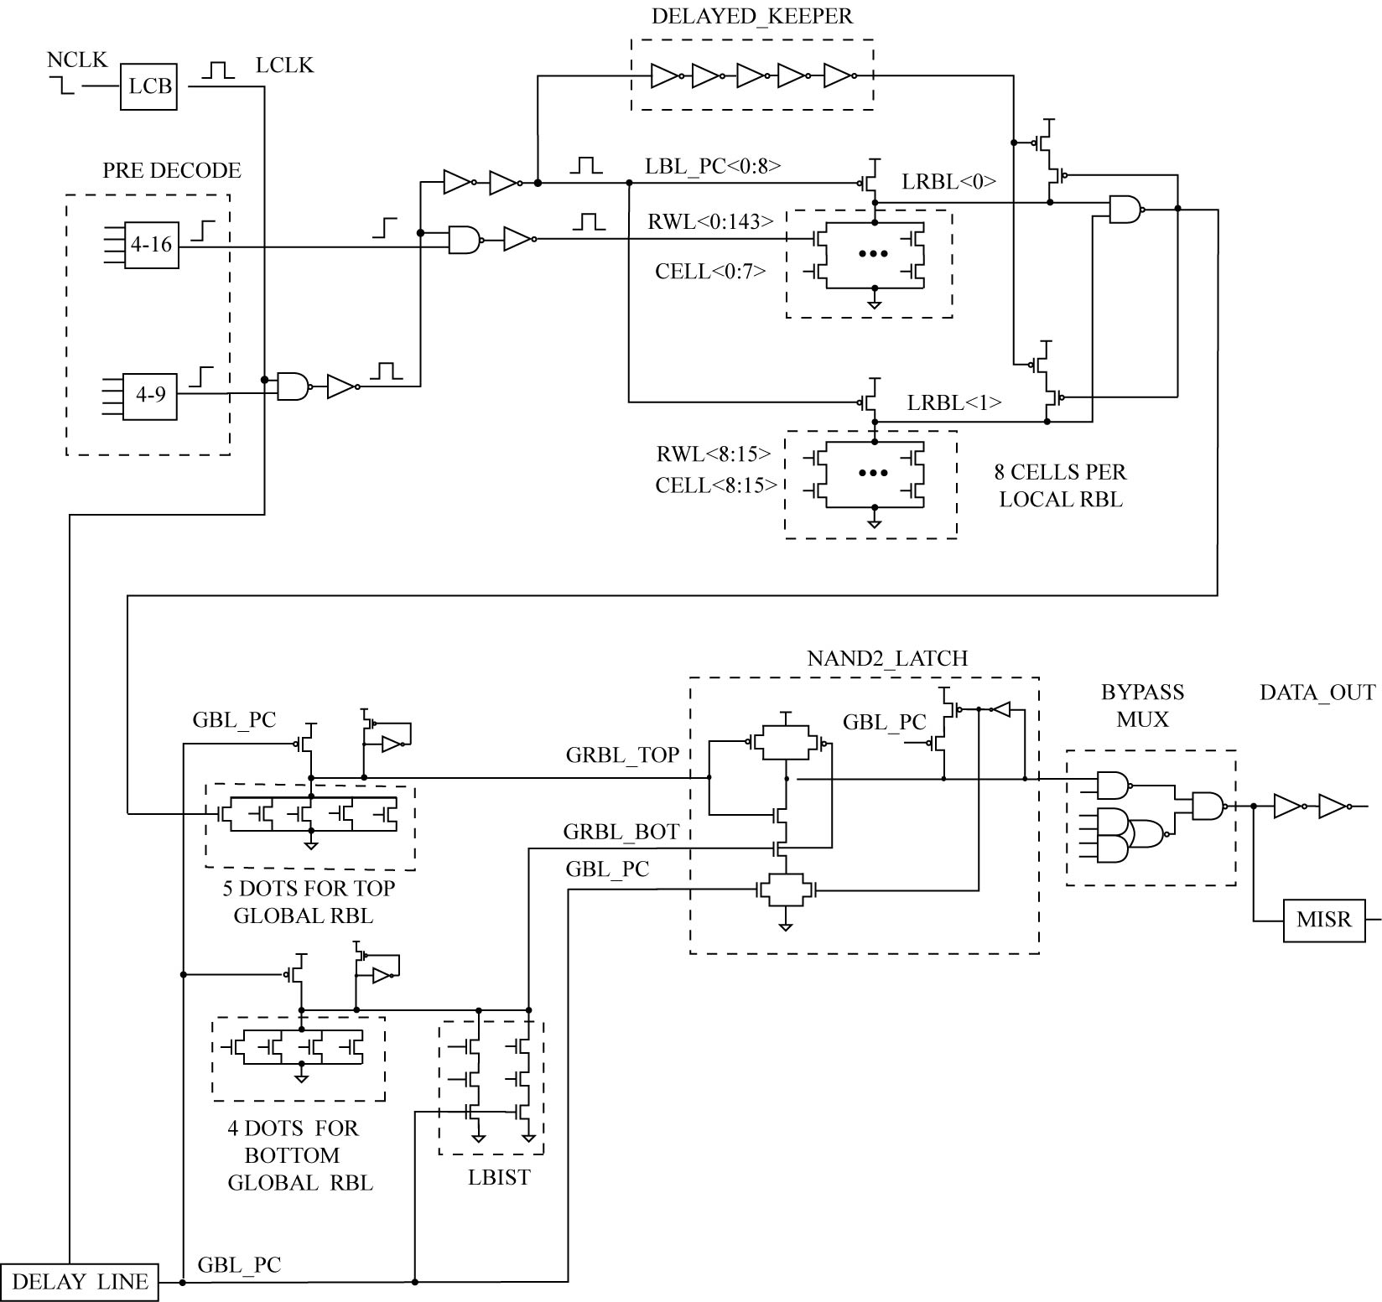
Read Cross Section
Figure 5: Circuit cross-section of the single-pumped read path in the implemented 4R2W register file array.

Slide 7
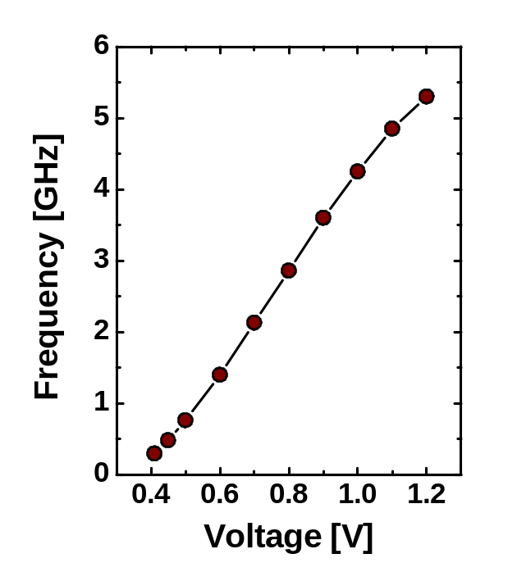
Organization | 144 entries × 78b (66b data + 12b parity)
Technology | 45nm SOI-CMOS
2R1W Cell size | 1.82μm × 0.76μm = 1.39μm²
Total area | 2 ×191μm × 231μm = 0.088mm²
Error correction | 2 data copies each w/parity
Voltage | 0.925V
Frequency | 2.3GHz
Read latency | 190ps (simulated)
Read/write power | ??? (simulated)
Leakage power | ??? (simulated)
Sample only
(example data from a different array)
(Use 3sigma fast hardware for this plot)
(RCH guys to help with this)
Figure 6: Measured characteristics of the fabricated array in 45nm SOI CMOS.

Slide 8
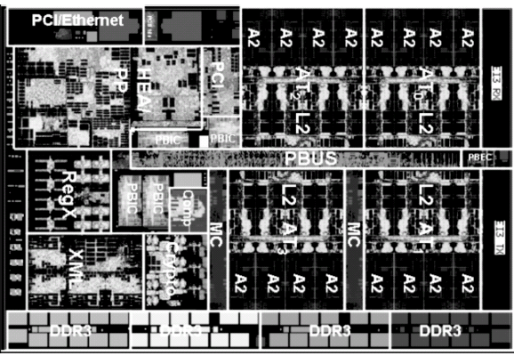
(Ask Charlie to help draw boxes in the right place)
Figure 7: Die photo of wire-speed POWER™ processor with 4R2W register file instances highlighted.

